Slide 1
JAC444 - Introduction to Java for C++ Programmers
Lesson 6: GUI Programming

Slide 2
Agenda
Java GUI API
Swing Classes
Layout Managers
Event-driving Programming

Slide 3
About the JFC and Swing
The Java Foundation Classes (JFC) are a graphical framework for building portable Java-based graphical user interfaces (GUIs).
JFC consists of the
Abstract Window Toolkit (AWT)
Swing
Java 2D.

Slide 4
AWT vs Swing
AWT GUI components are replaced by more versatile and stable Swing GUI.
AWT components are referred to as heavyweight components.
There is a equivalent Swing component for most AWT components.
Swing components are named JXxx.
JFrame, JPanel, JApplet, JDialog, JButton, etc.
Mixing AWT and Swing is doomed

Slide 5
The Java GUI API
GUI API is classified into 3 groups:
Component Classes, Container Classes and Helper Classes
Component Classes
An instance of Component can be displayed on the screen.
Component is the root class of all the UI classes.
JComponent is the root class of all the lightweight Swing components.
JComponent and its subclasses are in javax.swing package.
JComponent classes includes:
Jbutton, Jlabel, JTextField, JTextArea, JRadioButton, JComboBox, ...

Slide 6
The Java GUI API
Container Classes
An instance of Container can hold instances of Component.
Container classes that work with Swing components:
Container, JFrame, JPanel, JApplet, JDialog.
GUI Helper Classes
Helper classes are used to describe the properties of GUI components.
Helper classes are in the java.awt package. e.g.
Graphics, Color, Font, FontMetrics, Dimension and
LayoutManager

Slide 7
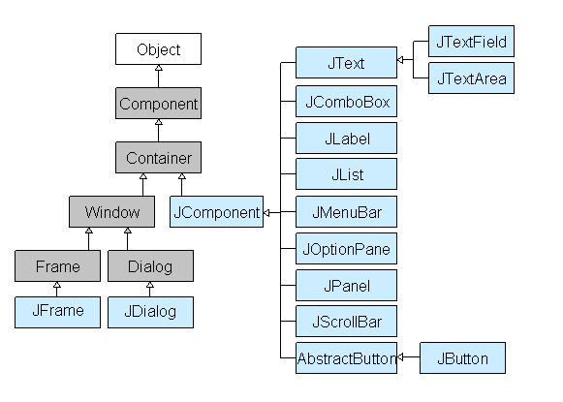
Swing Hierarchy
The Swing library is built on top of the AWT.
All components in Swing are Jcomponents
Jcomponents can be added to windows like JFrames or JDialogs.

Slide 8
Frame
A frame (JFrame) is one of the top-level containers (Window, JFrame, Frame, JDialog, Dialog and Applet).
Unlike other Swing components, we have to specifically set a JFrame to visible. e.g.
jp.setVisible(true); // jp is a container obj
Closing the window (using the ''X'' button of the title bar for example) will hide the frame, but it will not terminate the program. e.g.
jp.setDefaultCloseOperation(JFrame.EXIT_ON_CLOSE); // will make the program terminate when the window is closed. jp is a container obj.

Slide 9
Creating a JFrame
creates an instance of JFrame ()
e.g. – JButtonDemo.java, JFrameDemo3.java
e.g. – extends JFrame
e.g. –
JFrameDemo7.java, JFrameDemo7B.java, JTextDemo_V1.java Reservation_V1.java, Reservation_V2.java, Reservation_V17.java

Slide 10
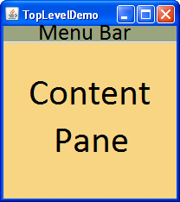
Content Pane and Panel
Content Pane: each top-level container may consist of 2 areas:
a Menu Bar
a content pane
A panel (JPanel) in a general-purpose container.
Used as subcontainers to group GUI components.

Slide 11
Layout Manager
Each container contains a layout manager.
e.g.
JPanel jp = new JPanel();
jp.setLayout( aLayoutManagerObject);
Some basic layout managers:
BorderLayout - default layout manager for JFrame
BorderLayout.NORTH, BorderLayout.EAST, BorderLayout.CENTER, BorderLayout.WEST, BorderLayout.SOUTH
E.g.
jp.setLayout( new BorderLayout() );
jp.add( new JButton( "subscribe" ), BorderLayout.NORTH );

Slide 12
FlowLayout
Add components to container from left to right
Alignment control:
FlowLayout.LEFT, FlowLayout.CENTER (default), FlowLayout.RIGHT
e.g. jp.setLayout( new FlowLayout( FlowLayout.RIGHT, 5, 20 ) );
jp.add( new JButton( "subscribe" ) );
GridLayout
Arrange components in a grid (matrix) formation.
E.g. jp.setLayout(new GridLayout(3, 3));
jp.add( new JButton( "subscribe" ) );
BoxLayout
javax.swing.Box.createHorizontalBox()
javax.swing.Box.createVerticalBox()
javax.swing.Box.createHorizontalStrut(10))

Slide 13
Examples
BorderLayoutManager.java
FlowLayoutManager.java
GridLayoutManager.java
BoxLayoutDemo.java
BoxLayoutDemo2.java
BoxLayoutDemo3.java

Slide 14

Event-driven Programming
The simple event model
To be a listener of an action event:
The object must be an instance of the ActionListener interface.
The object, listener, must be registered with the event source object:
e.g. source.addActionListener(listener)

Slide 15
Event Types, Listener Interface, Methods, User Action
Event Types | Listener Interface | Listener Interface Methods | Source Object & Events
ActionEvent | ActionListener | actionPerformed(ActionEvent e) | JButton, clicked; JTextField, Enter pressed; JComboBox, item Selected; JRadioButton, (un)checked; JCheckBox, (un)checked;
ItemEvent | ItemListener | itemStateChanged(ItemEvent e) | JComboBox, item Selected; JRadioButton, (un)checked; JCheckBox, (un)checked;
MouseEvent | MouseListener | mouseClicked(MouseEvent e) mousePressed(MouseEvent e) mouseReleased(MouseEvent e) mouseEntered(MouseEvent e) mouseExited(MouseEvent e) | Mouse: pressed, released, clicked, entered, exited
 | MouseMotionListener | mouseDragged(MouseEvent e) mouseMoved(MouseEvent e) | Mouse: moved, draged
KeyEvent | KeyListener | keyPressed(MouseEvent e) keyReleased(MouseEvent e) keyTyped(MouseEvent e) | Key: pressed, released, typed

Slide 16
Coding Listener Classes
Based on the event type (e.g. ActionEvent), create the event listener class by implementing appropriate listener interface (e.g. ActionListener)
Class OKListener implements ActionListener {
public void actionPerformed(ActionEvent e) {
// TODO …
}
}
A listener can listen more than one events of the same event type:
class RadioHandler implements ItemListener {
public void itemStateChanged(ItemEvent e) {
if ( (e.getSource() == jrb1)
&& (e.getStateChange() == ItemEvent.SELECTED) )
info[0] = "VIP";
else if ( (e.getSource() == jrb2)
&& (e.getStateChange() == ItemEvent.SELECTED) )
info[0] = ((JRadioButton) e.getSource()).getText(); // if this way, no need to check which button is selected!
}
}

Slide 17
Example Code
Example of a JButton object fires ActionEvent:
// Create source object
JButton jbtOK = new Jbutton(“OK”);
// create listener object
OKListenerClass listener1 = new OKListenerClass();
// register listener
jbtOK.addActionListener(listener1);

Slide 18
Creating Listener Classes
Top-level classes
Inner Class Listeners
Anonymous (inner) Class Listeners

Slide 19
Examples
creates an instance of JFrame ()
Event handlers are top-level classes (passing or not passing message.)
e.g. JButtonDemo.java, JFrameDemo3.java
extends JFrame
Event handlers are named inner classes
JFrameDemo7.java, JFrameDemo7B.java, Reservation_V17.java
Event handlers are Anonymous inner classes
JTextDemo_V1.java
Reservation_V1.java, Reservation_V2.java, Reservation_V17.java

Slide 20
Some JComponent classes
Jbutton
Jlabel
JTextField
getText()
JTextArea
setText(str)
JRadioButton
setSelected(true), isSelected()
JCheckBox
JComboBox
setSelectedIndex(index), getSelectedIndex() // start from 0
getSelectedItem()

Slide 21
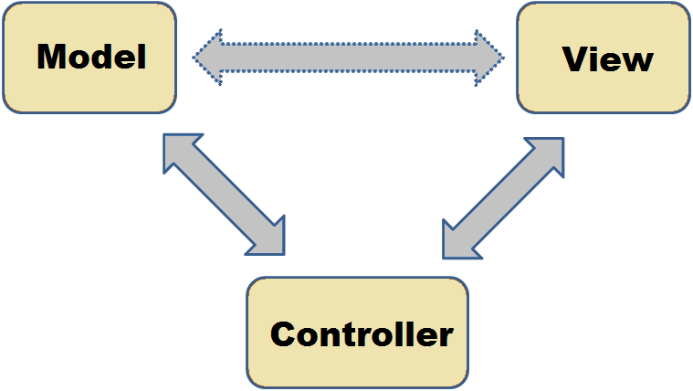
Java SE Application Design With MVC
What Is Model-View-Controller (MVC)?
In OOP development, model-view-controller (MVC) is the name of a methodology or design pattern for decoupling data access and business logic from the manner in which it is displayed to the user.

Slide 22
Model-View-Controller (MVC)
MVC can be broken down into three elements:
Model - The model represents data and the rules that govern access to and updates of this data.
View - The view renders the contents of a model. It specifies exactly how the model data should be presented. If the model data changes, the view must update its presentation as needed.
This can be achieved by using a push model, in which the view registers itself with the model for change notifications, or a pull model, in which the view is responsible for calling the model when it needs to retrieve the most current data.
Controller - The controller translates the user's interactions with the view into actions that the model will perform. In a stand-alone GUI client, user interactions could be button clicks or menu selections, whereas in an enterprise web application, they appear as GET and POSTHTTP requests.

Slide 23
Resourceful Links
Model-View-Controller (MVC) Structure
Java SE Application Design With MVC
JavaFX

Slide 24
Thank You!

